Slide 1
HACKATHON 2: School Admissions Classification
Hadeel Mabrouk - 900163213
Mohammed Abuelwafa - 900172603
Notes:
Good evening Dr. Nouri and Synapse Analytics judges.. This is Mohamed and myself Hadeel and today we’re going to present our solution for the second hackathon about school admissions classification

Slide 2
01
Problem Statement

Slide 3
Problem Statement
Predicting the Enrollment Statuses of School Admission Requests Given Applicant’s Data
Notes:
So starting with our problem statement, simply put the problem we’re trying to solve is to predict enrollment statuses of school admission requests given some information about the student and their parents, including their income level, job title, bank account balance, ..etc.

Slide 4
02
Proposed Solution

Slide 5
Proposed Solution
Feature Engineering
Model
Learning & Making Most Contributing Factors
Binary Classification
Attributes
Label
Data about Students & Their Parents
Whether the Applicant is Enrolled or not
Notes:
Accordingly, we believe that the problem we're tackling is a classification problem for which the independant variables are the sutdent's information and the response variable is whether or not they will be enrolled. To define the most contributing factors, we shall start by doing some descriptive analytics and feature engineering on the features that we believe are of high importance (given the domain knowledge). Following that, we shall build a set of binary classifiers to compare and contrast their results, and to better learn the feature importance given the algorithm(s) performance.

Slide 6
03
Descriptive Analytics

Slide 7
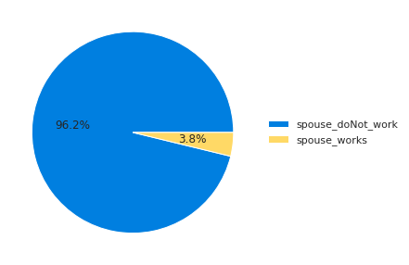
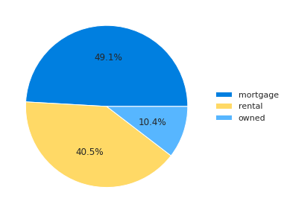
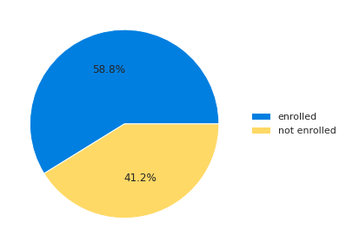
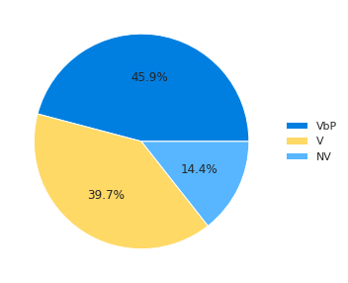
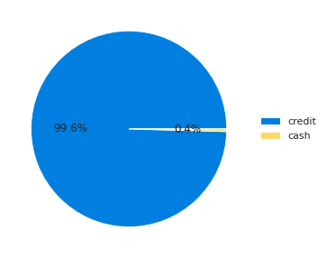
Categorical Data Analytics
Notes:
We also tried to look up the interpretation of the location to learn if we can cluster them into smaller groups to include them in the classifier aftewards. However, we couldn't find relevant information upon doing more research.

Slide 8
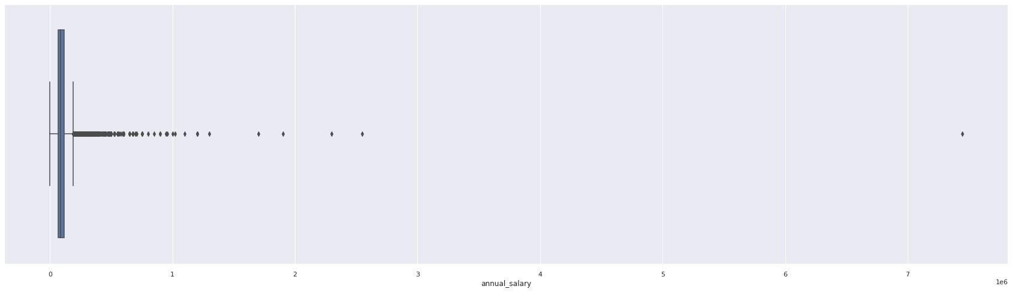
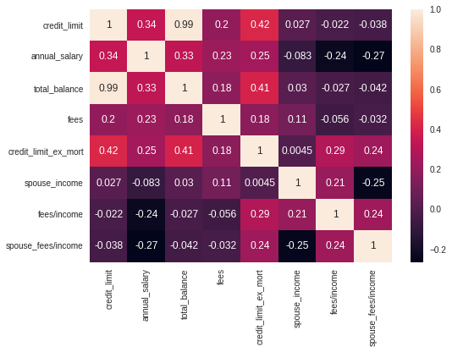
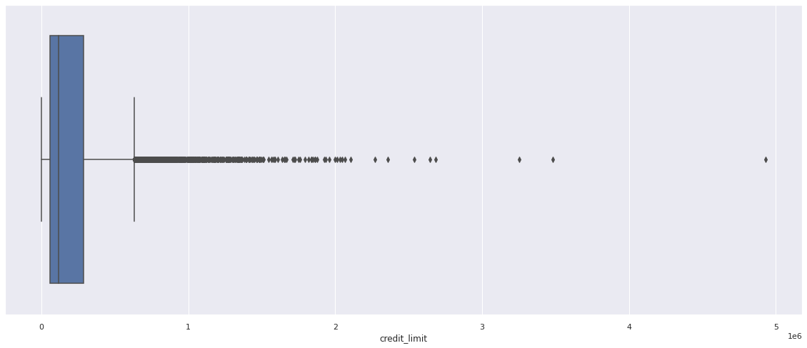
Numerical Data Analytics
What about Down Payment?
Leakage Variable
Notes:
We noticed that the 'down_payment' column only has a non-zero value if the applicant got accepted, meaning that it serves as a leakage variable, and hence we decided to exclude it.
Also, we tried to invistigate the meaning of the 'fees/income' column. In the columns description, it's mentioned that it is the ratio of school fees to the applicant's whole income. However, when we divide the fees over the annual salary it results in majorly different numbers. To further invistigate the meaning of the column to learn why this might be happening, we plotted the heatmap across the variables that we think might be related to the ratio. Surprisingly, we found that the ratios are highly correlated to the credit cards limit excluding the mortgage deductions. On the contrary, it's less correlated to the applicants annual salary.

Slide 9
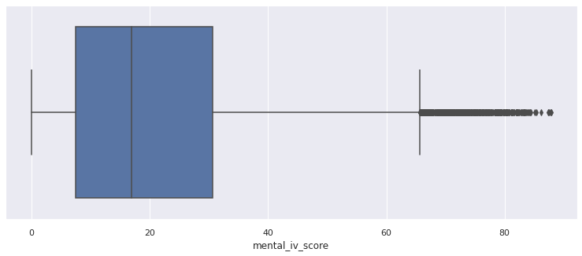
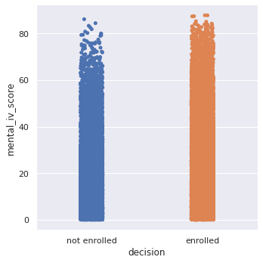
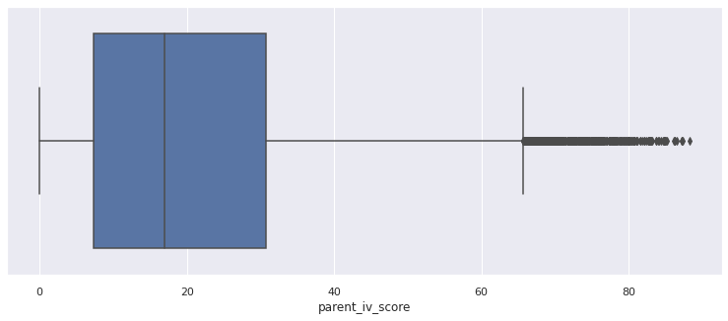
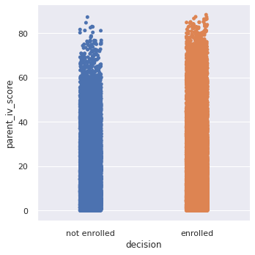

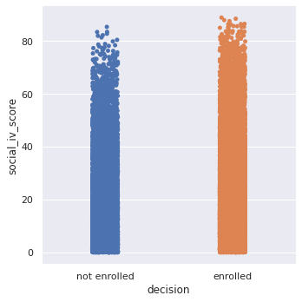
IV Score Analysis
Mental Score
Parental Score
Social Score
→ Outliers Cutoff : ~66

Slide 10

Is There a Relationship?

Slide 11
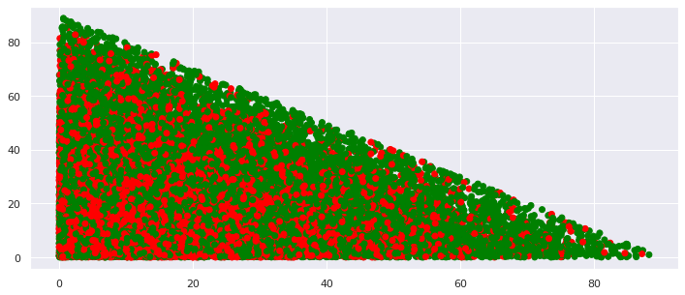
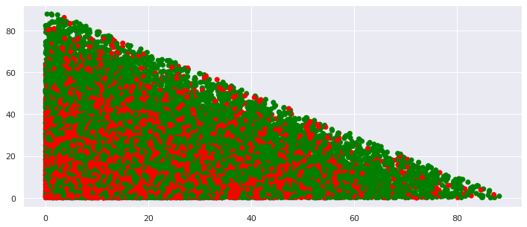
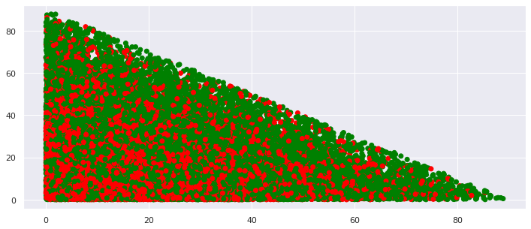
Parental vs Social
Parental vs Mental
Mental vs Social

Slide 12
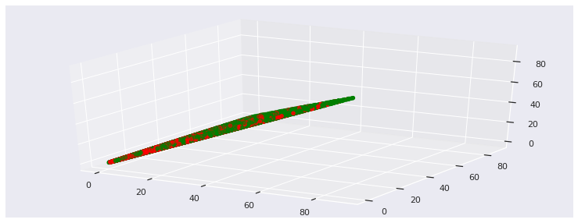
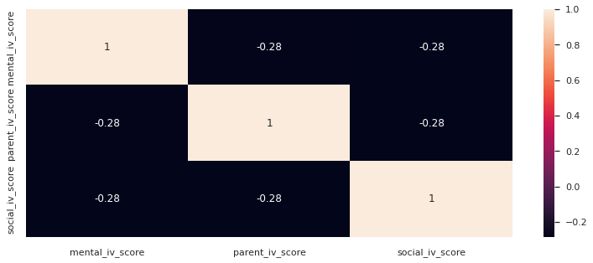
Combined Relationships
Takeaway: There is a threshold for the scores to be at: 90
Notes:
There is a threshold for the scores to be at:
(whether alone or added in twos or all of them)

Slide 13
Feature Engineering
01
Merging Spouses Incomes
02
Clustering Job Titles
03
Categorical Data One-Hot Encoding
Notes:
Instead of incorporating each of the parents' salaries independantly, we though of merging them to have a new feature representing the total salary of the family. Additionally, we added an extra feature that represent the total salary per child by dividing the total salary/#(children in the family + 1), which can give an indication about the share of each child in the family in the parents' salaries.
For the verification columns, and since we merged both parents salaries, we made a new column to serve as some sort of an interaction variable between the two verification columns of both parents, as shown in the code according to the following conditions.
We also believed that the job name information shall be of high value, especially given that it can give an indication about the social class of the family. Instead of using the whole ~80 categories, we decided to semantically group similar professions based on our judgement as a team, as shown in the code below.

Slide 14
04
Predictive Analytics

Slide 15
Used Features
We Experimented with different subsets of the features with multiple classification models
This subset produced the best results:
House Type
Previous Grade Percentage
IV Scores
Annual Salary + Salary Verification Info
Total Balance
Credit Limit Excluding Mortgage
Fees/Income

Slide 16
Experimented Models
Decision Tree | Random Forest | SVM | NL SVM | Gradient Boosting Classifier | MLP Network
61.63% | 70.63% | 59.78% | 58.93% | 71.06% | 58.93%

Slide 17
05
Recommendations & Conclusion

Slide 18
Recommendations
Based on our understanding of the domain knowledge, our recommendation is that the school can use the following features instead to help make better decisions regarding the status of the applications:
Student's Previous Grade
Parents' Total Salaries / #Children
Mental, Social, and Parent IV Scores
Notes:
Based on our descriptive analytics, our recommendation is that the school can use the following features instead to help make better decisions regarding the status of the applications:
Student's Previous Grade (Given that it was by far the most important feature in the Random Forest Classifier)
Parents' Total Salaries / #Children (while taking into account the level of verification for the given salaries)
Mental, Social, and Parent IV Scores

Slide 19
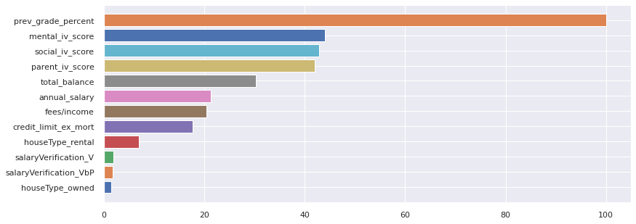
Recommendations
Based on our predictive analysis, the most features that contributed to the classifier performance are the following:
Instead of spending time and effort on manual screening, we can make use of our classification model that takes into account extra features, such as the house type, salary verification, Total Balance, Annual salary … etc.

Slide 20
Conclusions
The Problem is a Classification Problem.
We recommend using the aforementioned
features and the classifier for future admissions.
No need for manual screening anymore.
Revising the fees/income ratio.
Combined features may be more useful.

Slide 21
Thanks!
Questions?
Please keep this slide for attribution

